Slide 1


Community Redevelopment Agency 2026 Performance Measures

Slide 2
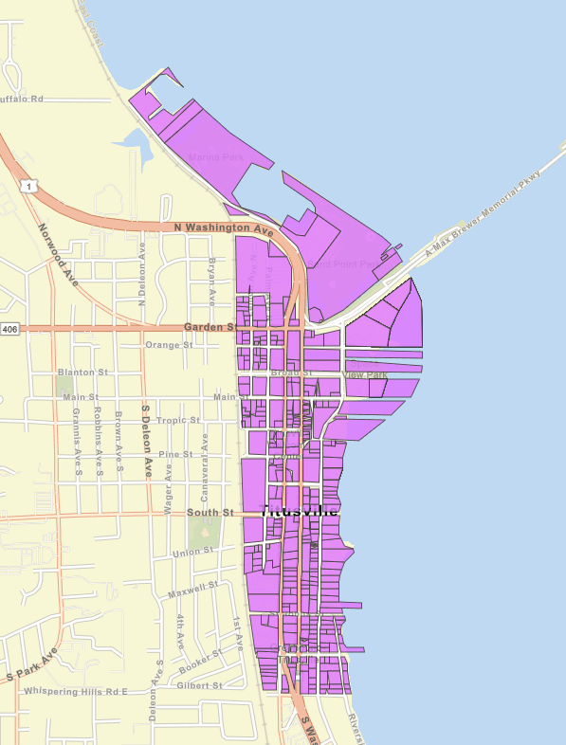


Titusville CRA
Goals & Objectives Analysis per FLORIDA STATUTE 189.062
Established in 1982
555 South Washington Avenue
Titusville, FL 32796
(321) 567-3860
www.Titusville.com

Slide 3
City of Titusville CRA strategic Plan
GOAL
TO ERADICATE BLIGHT CONDITIONAS AS IDENTIFIED IN THE 1982 FEASIBILITY STUDY BASED ON F.S. 163.387

Slide 4

Goals & Objectives
GOAL 1 - ADMINISTRATION OF THE CRA
Objective –To maintain cost-effective operation of the Community Redevelopment Agency and effective administration for achievement of redevelopment goals and maintain compliance with legal requirements.
GOAL 2 – HOUSING
Objective – Promote, encourage, and incentivize residential development and occupancy within the CRA and encourage improvement and rehabilitation of deteriorating residential housing stock within the CRA.
GOAL 3 – COMMUNITY AND CULTURE
Objectives – Preserve and promote Titusville’s historic assets and resources. Support private sector and community efforts to develop additional entertainment and performance venues, gallery spaces, and lodging facilities. Support and promote the installation of public art within the CRA.

Slide 5
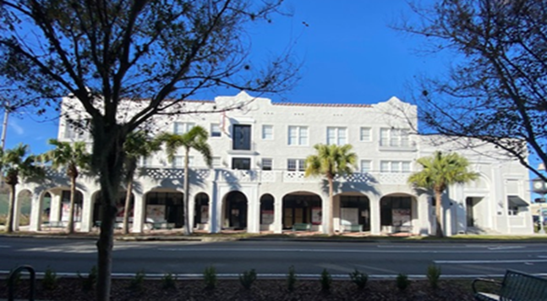
Goals & Objectives (Continued)
GOAL 4 – ECONOMIC DEVELOPMENT
Objectives – Increase private sector investment, small business development , and economic activity within the CRA. Increase utilization of underdeveloped and underutilized parcels. Recruit and retain businesses by acting as a liaison, resource, and advocate for existing and potential businesses within the CRA. Encourage hospitality, lodging and entertainment venue development within the CRA.
GOAL 5 – PUBLIC SPACES
Objective – Create safe and accessible public spaces within the CRA while creating a visually unified CRA utilizing a consistent design theme. Evaluate vacant and underutilized sites for the development of public open space.

Slide 6
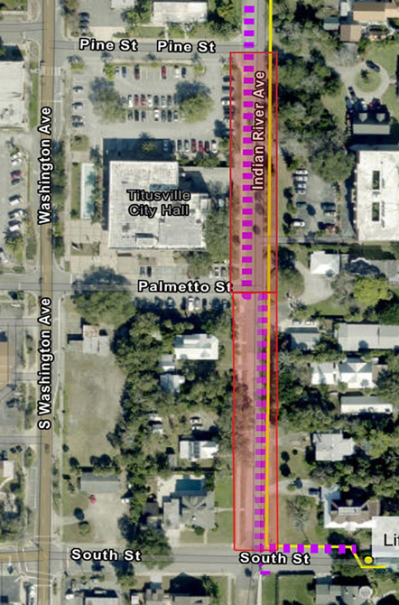
Goals & Obj (Continued)
GOAL 6 – INFRASTRUCTURE
Objectives – Prioritize infrastructure improvements and amenity installation that will facilitate new development and redevelopment projects within the CRA. Ensure the preservation of the natural environment and appropriate management of vital natural resources.
GOAL 7 – PUBLIC HEALTH AND SAFETY
Objectives – Improve community safety within the CRA. Provide training to CRA staff and community regarding public health and safety issues. Improve pedestrian and bicyclist safety within the CRA.
GOAL 8 – REGULATORY ENVIRONMENT
Objective – Evaluate current development regulations to identify potential revisions that would encourage additional private sector development within the CRA.

Slide 7
Florida Statute 189.0694
These new requirements aim to increase accountability and transparency for special districts by ensuring they have clear objectives and are regularly assessing their performance. The annual reporting requirement will provide stakeholders with insights into the effectiveness of special district programs and activities.
All special districts must establish goals and objectives for each program and activity they undertake by October 1, 2024.
Special districts are required to create performance measures and standards to determine if their goals and objectives are being achieved.
An annual report must be published by December 1 each year, which must include:
A description of the goals and objectives achieved
The performance measures and standard used to make this determination
A list of any goals or objectives that were not achieved
HB 7013, which passed on April 26, 2024, makes several important changes to the laws governing special districts, including Community Redevelopment Agencies (CRAs). The bill revises Florida Statue 189.0694 with the following key requirements:

Slide 8
FY 2026 Budget Summary
Category | Amount
Total CRA Fund | $1,167,804
Revenue Sources
– County Contribution | $370,000
– City Contribution | $797,804
Expenditures
– Personnel (4 employees – salaries & benefits) | $288,353
– Operating Expenses | $227,315
– Capital Projects | $374,456
-- Building Grants – Aid to private Organizations | $110,000
-- Public Improvements Revenue Note (PIRN) | $117,680

Slide 9
Operating and Capital Initiatives
FY 2026 Budget
Initiative | Amount
Trail Town Amenities | $30,000
CRA Grant Program | $110,000
Infrastructure (Safety Improvements) | $244,465
Broad Street Improvements | $100,000

Slide 10
CRA Projects FY26 Budget
USES – GOALS | CRA Page | Accounting String | Project Number | Project Name | New Project Allocations FY26
Public Spaces Infrastructure | 48,49,45 | 104-5555-515.65-00 | CR1604 | Trail Town Amenities | $30,000
Economic Development CRA Administration | 45,37 | 104-5555-515.65-00 | CR1703 | Building Grant Program | $110,000
Infrastructure Economic Development Public Safety | 51,46 | 104-5555-515.65-00 | Not assigned | Safety Improvements | $244,465
Infrastructure Economic Development Community and Culture | 45,50,51,55 | 104-5555-515.65-00 | CR2501 | Broad Street Streetscape | $100,000

Slide 11
CRA FY26 Budget Initiatives – Performance Standards & Measures
Category/Initiative | Performance Standards | Measurements
Trail Town Amenities – $30,000 | Enhance trail-related infrastructure to support tourism and economic activity. | # of new trail amenities installed (bike racks, water stations, signage, wayfinding).
CRA Grant Program – $110,000 | Support business/property owners in improving buildings and increasing occupancy. | # of façade and interior renovation grants awarded.
Infrastructure (Safety Improvements) – $244,465 | Implement infrastructure upgrades that improve safety and accessibility. | # of safety-related infrastructure projects completed (crosswalks, lighting, stormwater, etc.).
Broad Street Improvements $100,000 | Advance Broad Street Curbless Streetscape improvements to support redevelopment. | % completion of design and construction phases.

Slide 12
PERFORMANCE STANDARDS AND MEASUREMENTS
By Dec 1, 2025, and annually thereafter, the City of Titusville CRA will post a report on the website as required by FS 189.0694.
Determine the number of installed Trail Town amenities installed within the CRA.
Evaluate the number of approved grant applications processed.
Determine the number of safety-related infrastructure projects completed.
Determine amount of completion of design and construction phases for the Broad Street Streetscape.
To evaluate the successful achievement of the goals and objectives as outlines in this report, the City of Titusville CRA will focus on the following performance measures:

Slide 13
Thank you
Titusville CRA
The Community Redevelopment Agency consists of seven members. Five members of City Council and two additional members.
Staff Liaison: Redevelopment Planner Sue Williams
(321) 567-3860
sue.williams@titusville.com
Present Members: Chairman Andrew Connors, Jo Lynn Nelson, Herman A. Cole, Jr., and Dr. Sarah Stoeckel.
Members At-Large: Dr. Greg Aker and James Mutter.
Registered Agent, City Manager and CRA Executive Director Thomas Abbate.
Titusville.com/228/Community-Redevelopment-Agency

